Slide 1

Bernard Thompson
Software Engineer @ Kargo
Higher Diploma in Computer Science (2018 - 2020)

Slide 2
Y2K - Now
HOW I GOT HERE
Musgrave’s Cash & Carry
Waterford Airport
Career in Tech
6 Years
A few months
12 Years
2 Years
5 Years and counting
Irish Defence Forces
Higher Diploma in Computer Science

Slide 3


Tech Roles/ Tech Stack
Jan 2019 - Jan 2022
App Dev consultant
Jan 2022 - Present
Software Engineer
Web/Enterprise Dev
Programming
Project Reviews
Mobile App Dev
Databases
Networking
Assignments/ Slack
XX
Frontend
Backend
DevOps
Principles
NodeJS
Python
Ruby
SQL
NoSQL
Swagger (API)
Git
RH Openshift
Argo CD
Jenkins
AWS
Docker
Heroku
Slack, G-suite
Standups
Retrospectives
Demo’s/Workshops
Design Thinking
Presentations, documentation...
ReactJS
Angular
Ionic
Swift
NPM
Yarn
HTML
CSS
Javascript
JQuery

Slide 4



WE BELIEVE IN THE POWER OF DESIGN
Kargo is the leader in innovative advertising solutions.
We using creative science to deliver extraordinary outcomes for businesses on mobile, video and social publishers.
We provide brands with a premium platform to deliver the most high-end, performance-optimized creative in the world.
We are building an omnichannel advertising suite to drive foot traffic, eCommerce and higher return on ad spend (ROAS) for retailers.

Slide 5



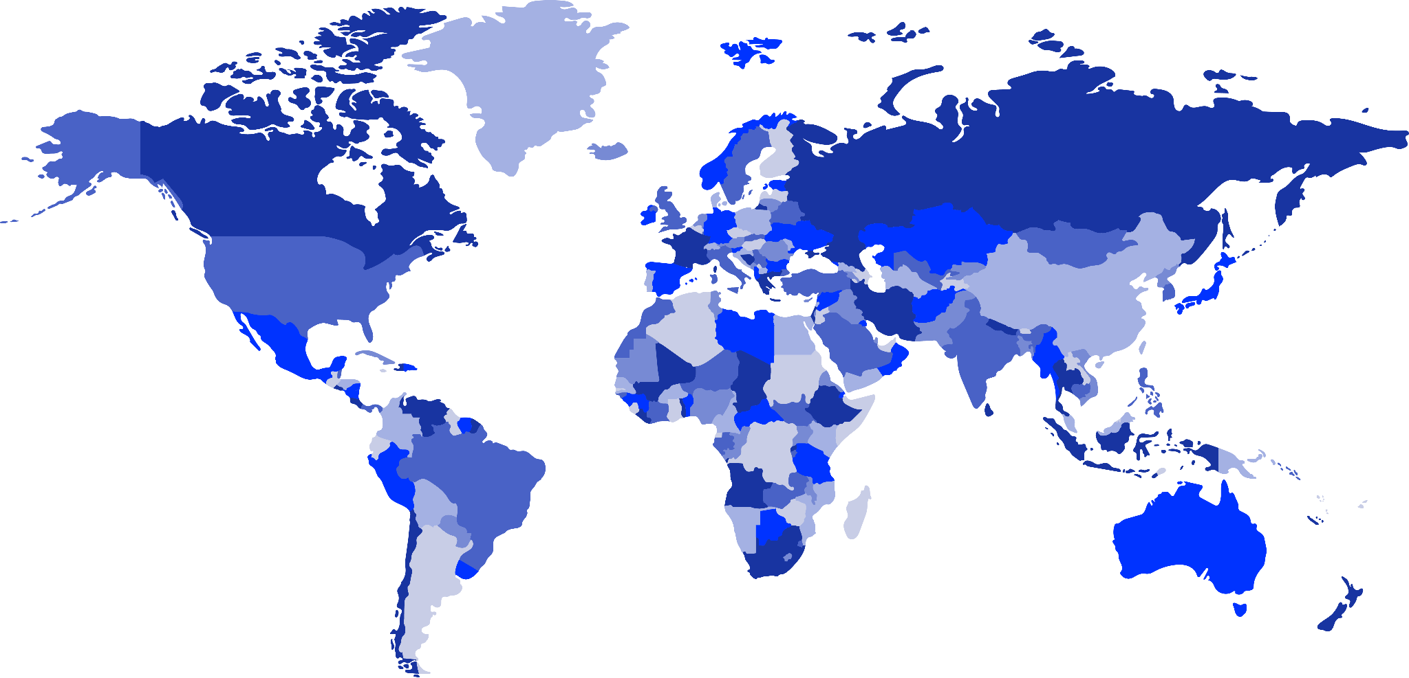
AROUND THE GLOBE
NEW YORK CITY, USA
WATERFORD, IRE
CHICAGO, USA
187 Employees
75 Employees
45 Employees
LONDON, ENG
10 Employees
SINGAPORE, AUSTRALIA, AND NEW ZEALAND
LOS ANGELES, USA
60 Employees
21 Employees
DALLAS, USA
40 Employees

Slide 6

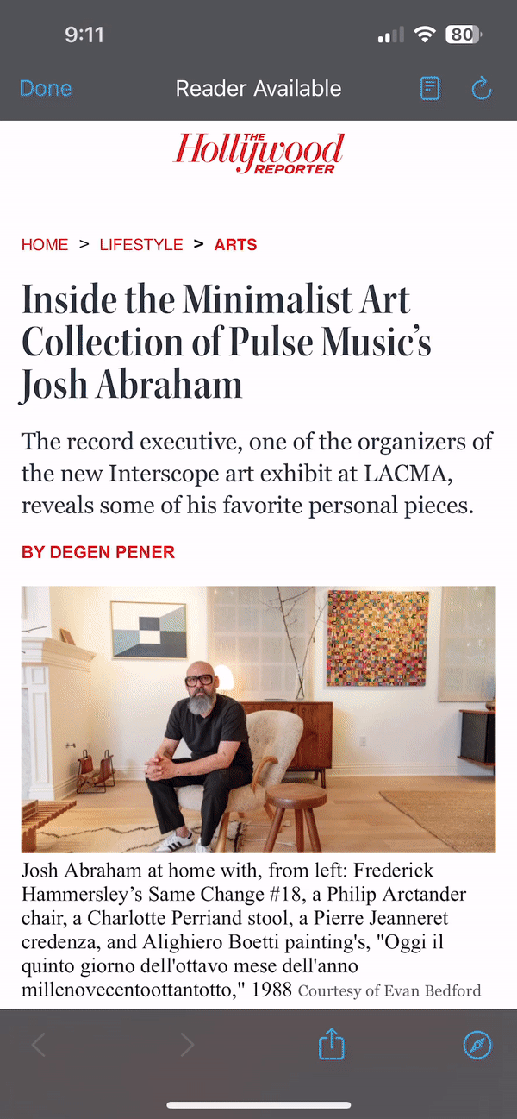
WHAT WE DO!
DELIVER MEMORABLE DIGITAL ADVERTISING AND CONTENT EXPERIENCES
We work with publishers to provide their properties with performant ad experiences that improve user experience.
Properties such as:
websites
video players
smart TV home screens
etc.
We work with advertisers to build eye-catching ad experiences that provide more awareness for their Brand.
For examples, see https://demo.kargo.com

Slide 7











ADVERTISERS
KARGO

Slide 8
DAY IN A LIFE
IN KARGO
9AM
Free breakfast
Standup
10AM
Coffee & snacks
Eng work
Feature development, bug fixing, research, etc.
11AM
Eng work
12PM
Eng work

Slide 9
DAY IN A LIFE
IN KARGO
1PM
Free lunch
Pool at the Games room
Chat with your colleagues
2PM
Meetings with USA colleagues
3PM
Meetings
Eng work
4PM
Eng work
Hack time

Slide 10
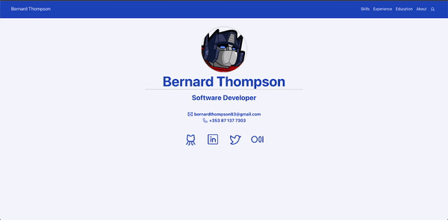
TOP TIPS
LANDING THAT JOB
Networking (colleagues / LinkedIn)
GitHub presence
Online Portfolio
Give yourself some credit

Slide 11

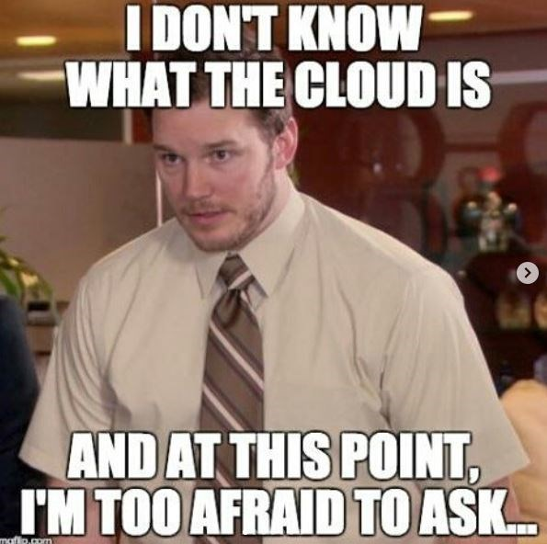

TOP TIPS
HELPERS
Git, Git & more Git
Ask Loads
Prepare to fail

Slide 12




Thank You
bernardthompson83@gmail.com
/bernardthompson83
/bonjo7
/bonjo7

